Slide 1

Supervisor meeting, Thursday May 7th

Slide 2
Progress
What was discussed in the previous meeting:
Complete RL loop
Set up HPC
What we did so far since previous meeting:
Set up HPC/Snellius terminal individually and tested our code on it
Used an untrained AI model provided by Snellius to see whether this works. Response time for batch of 4 is approx. 30 seconds >>>> 30 minutes locally.
Made a version of the reward function that handles invalid topologies and normalizes fitness/grpo scores in a range between -1 and 1.
Zijian connected the RL loop

Slide 3
Progress
Results?
We aren’t able to generate results yet, due to following problems:
LTspice is not available on Linux, only Windows -> Need ‘Wine’, a module that translates Windows calls to Linux calls. Not a bottleneck, times to translate is significantly low. For this reason the simulation step can not be run. Already contacted SSC, haven’t received a response yet :(. Zijian tests RL loop, with already existing results (from local testing).
Updating model weights works good with LoRa, however after a single policy update, process results in an Out of Memory error. Theoretically, Qwen 14B needs 16GB VRAM, but NVIDIA A100 has 40GB VRAM, so the issue is not exactly clear.

Slide 4
Second version overview (Not complete yet)
batch_id/LLM_output/*.net
validation_results.json
Using a model provided by snellius (Qwen-3-14B) to generate topologies and train.
Validation algorithm goes over each topology using a checklist
Valid topologies are considered for simulation, necessary metrics are extracted from the simulation results.
simulation_results.csv
Update weights
reward_results.json
GRPO loop, processes the scores and updates the weights.
Extracted metrics are used to measure fitness score in reward function

Slide 5

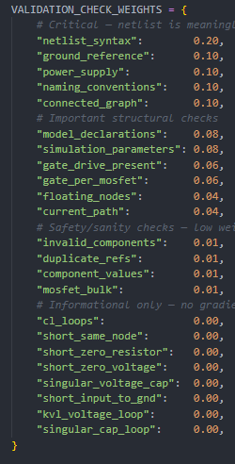
Handling invalid topologies
The fitness score is used to calculate a GRPO score ranging between -1 and 1. This is a range that the policy prefers.
Topologies that are invalid are rewarded based on how close to being valid they are. The calculation involves weights per check. Their GRPO score is between -1 <= x < 0 (e.g. a topology failing on ALL checks = -1.
Topologies that are valid are rewarded based on their simulation results. Their GRPO score is between 0 <= x <= 1.
Fitness scores are in the range of -1 and 0. Invalid is between -1 and -0.5 and valid is between -0.5 and 0

Slide 6
Current RL Pipeline
Output Metric
Read Existing Files:
LLM_output/*.net
reward_results.json
↓
GRPOTrainer
↓
RLUpdater.update()
↓
LoRA weight update
{
"num_valid_samples": 2,
"mean_reward": 0.2786,
"advantages": [1.0, -1.0],
"policy_loss": -8.0
}
Notes:
(prompt, completion, reward)

Slide 7
Bottlenecks:
Optimization Directions:
RL Memory Optimization
shorter context length
gradient accumulation
reduce batch samples
Simulation Integration
investigate LTspice + Wine
consider NGSpice / Xyce alternatives
Current Stable Setup:
2 samples(prompt, generated netlist, reward)
single-step RL
LoRA only
no reference model
LTspice not on HPC.
VRAM / CUDA OOM:
Qwen3-14B training exceeds 40GB VRAM
especially during backward pass

Slide 8
Next steps
Fix issues
Start training
Since there is no meeting next week (so we have 2 weeks), try testing and show results.

